Slide 1
Data-Moderate Research
Dr. Laure Zanna, Professor at NYU
Dr. Carl Vondrick, Asst. Professor at Columbia
Research Co-Directors

Slide 2
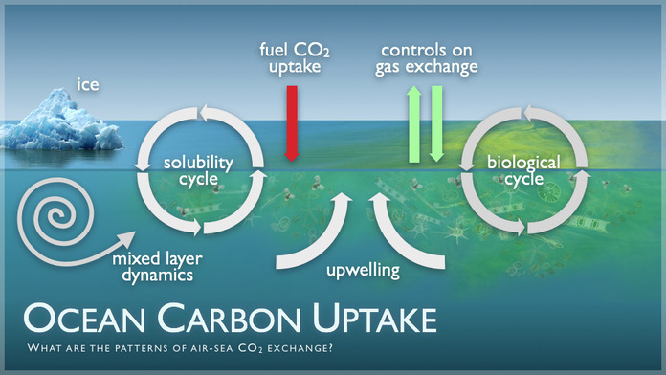
Equations are often unknown
Only approximate solutions
Incorrect representation in climate models
Moderate observational data available

Slide 3
What’s missing in machine learning?
Generalization
Causal reasoning
Interpretability
Blackbox
X
Y

Slide 4
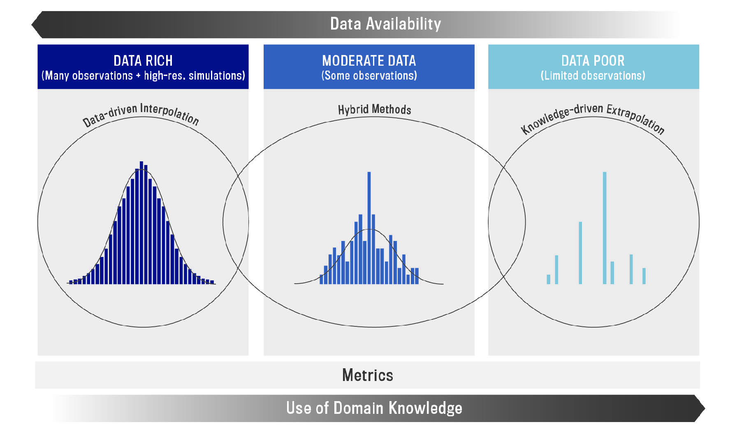

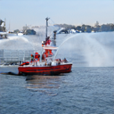
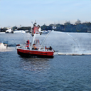
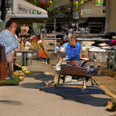
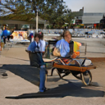
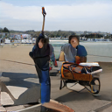
Neural synthesis drives ML generalization
4
Observational
Distribution
Neural Synthesis
Interventional
Distribution
Mao, Gupta, Cha, Yang, Vondrick. Under Review. 2020.

Slide 5
What’s missing in machine learning?
Generalization
Causal reasoning
Interpretability
Blackbox
X
Y

Slide 6
Causal inference enables richer analysis
Level | Typical Question | Examples
Associational | How are X and Y related? | What do clouds tell us about rain?
Bareinboim and Pearl. PNAS. 2016.
6

Slide 7
LEAP reasons about causal structure
Level | Typical Question | Examples
Associational | How are X and Y related? | What do clouds tell us about rain?
Interventional | What if X? | If more clouds form, will there be more rain?
Counterfactual | Why X? | Did the clouds create rain?
Bareinboim and Pearl. PNAS. 2016.
6

Slide 8
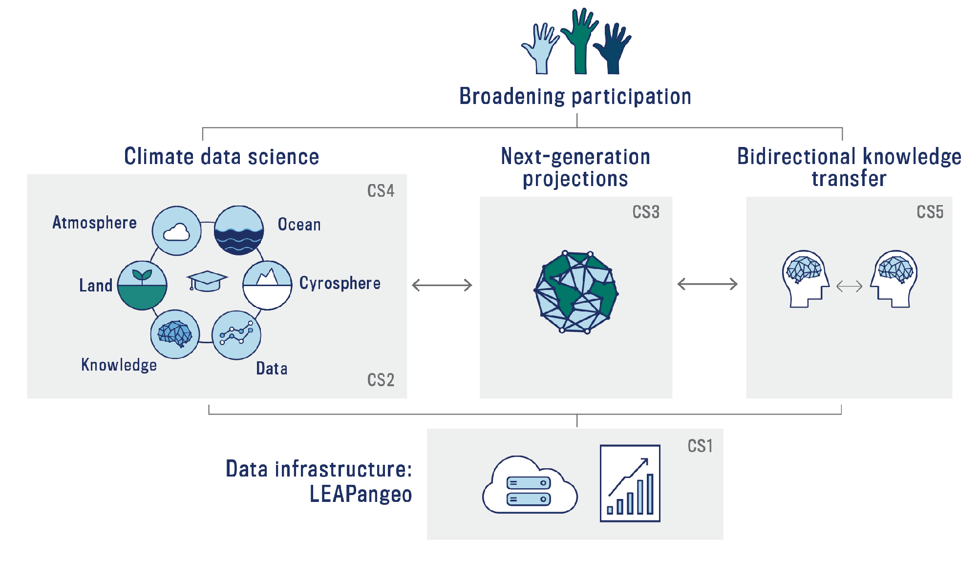
Causality impacts both research and knowledge transfer
6

Slide 9
What’s missing in machine learning?
Generalization
Causal reasoning
Interpretability
Blackbox
X
Y

Slide 10
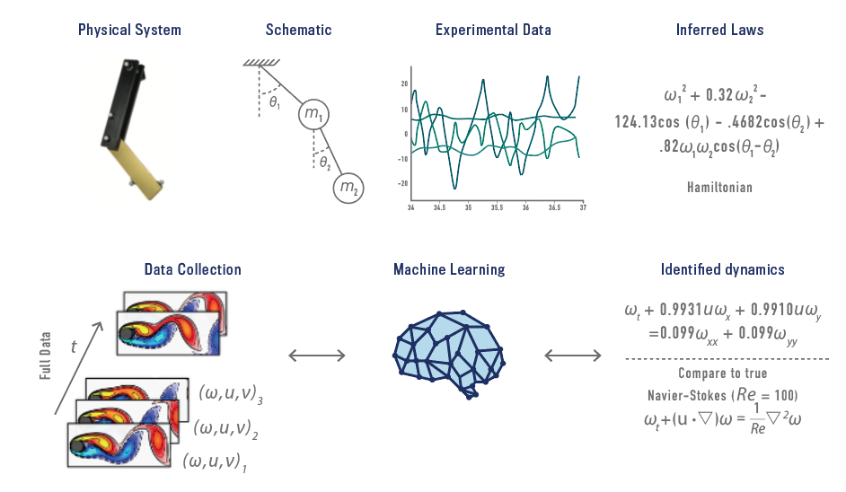
Learning governing equations from data
Conservations, symmetries & invariants
symbolic regression
Schmidt & Lipson, Science, 2009

Slide 11
Learning governing equations from data
Conservations, symmetries & invariants
Learning complex time-evolution of known systems
sparse regression
Rudy et al, Science Advances, 2017

Slide 12
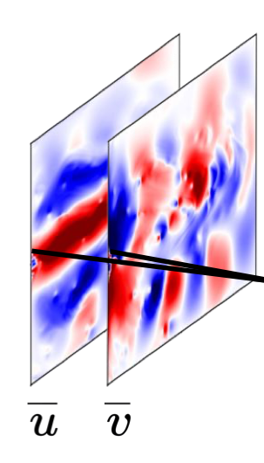
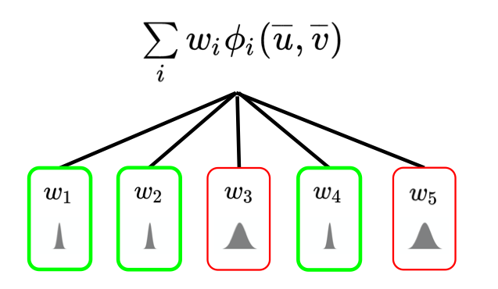
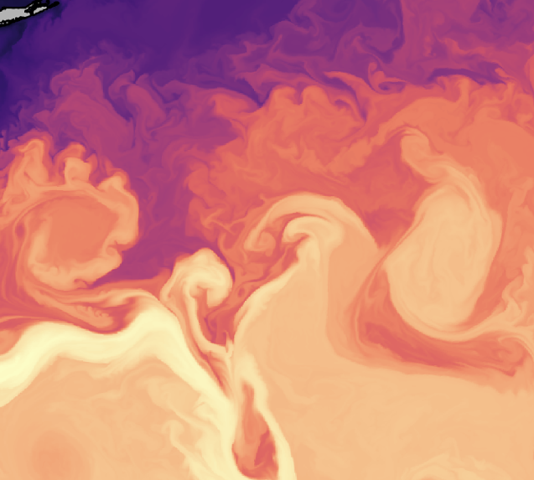
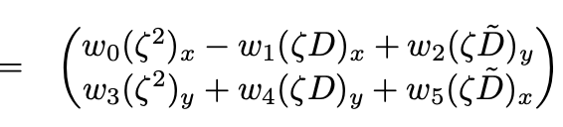
Learning governing equations from data
Conservations, symmetries & invariants
Learning complex time-evolution of known systems
Unknown processes
~100km
Baseyian sparse regression
Zanna & Bolton, 2020

Slide 13
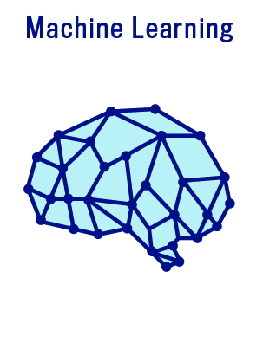
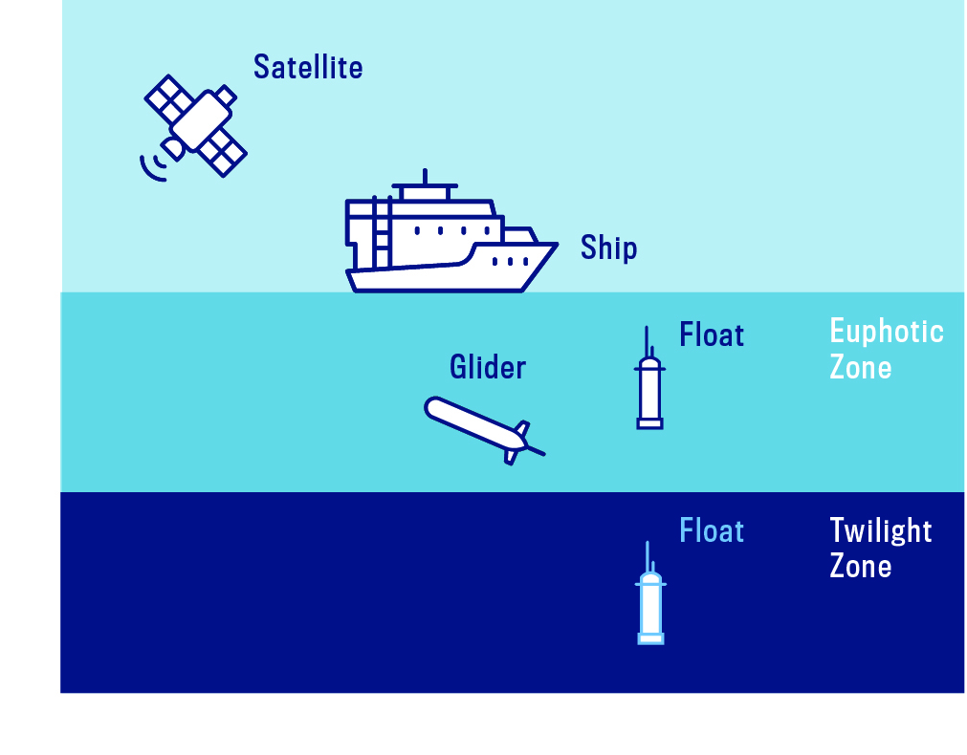
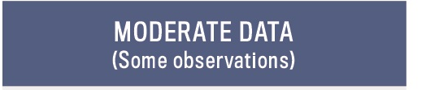


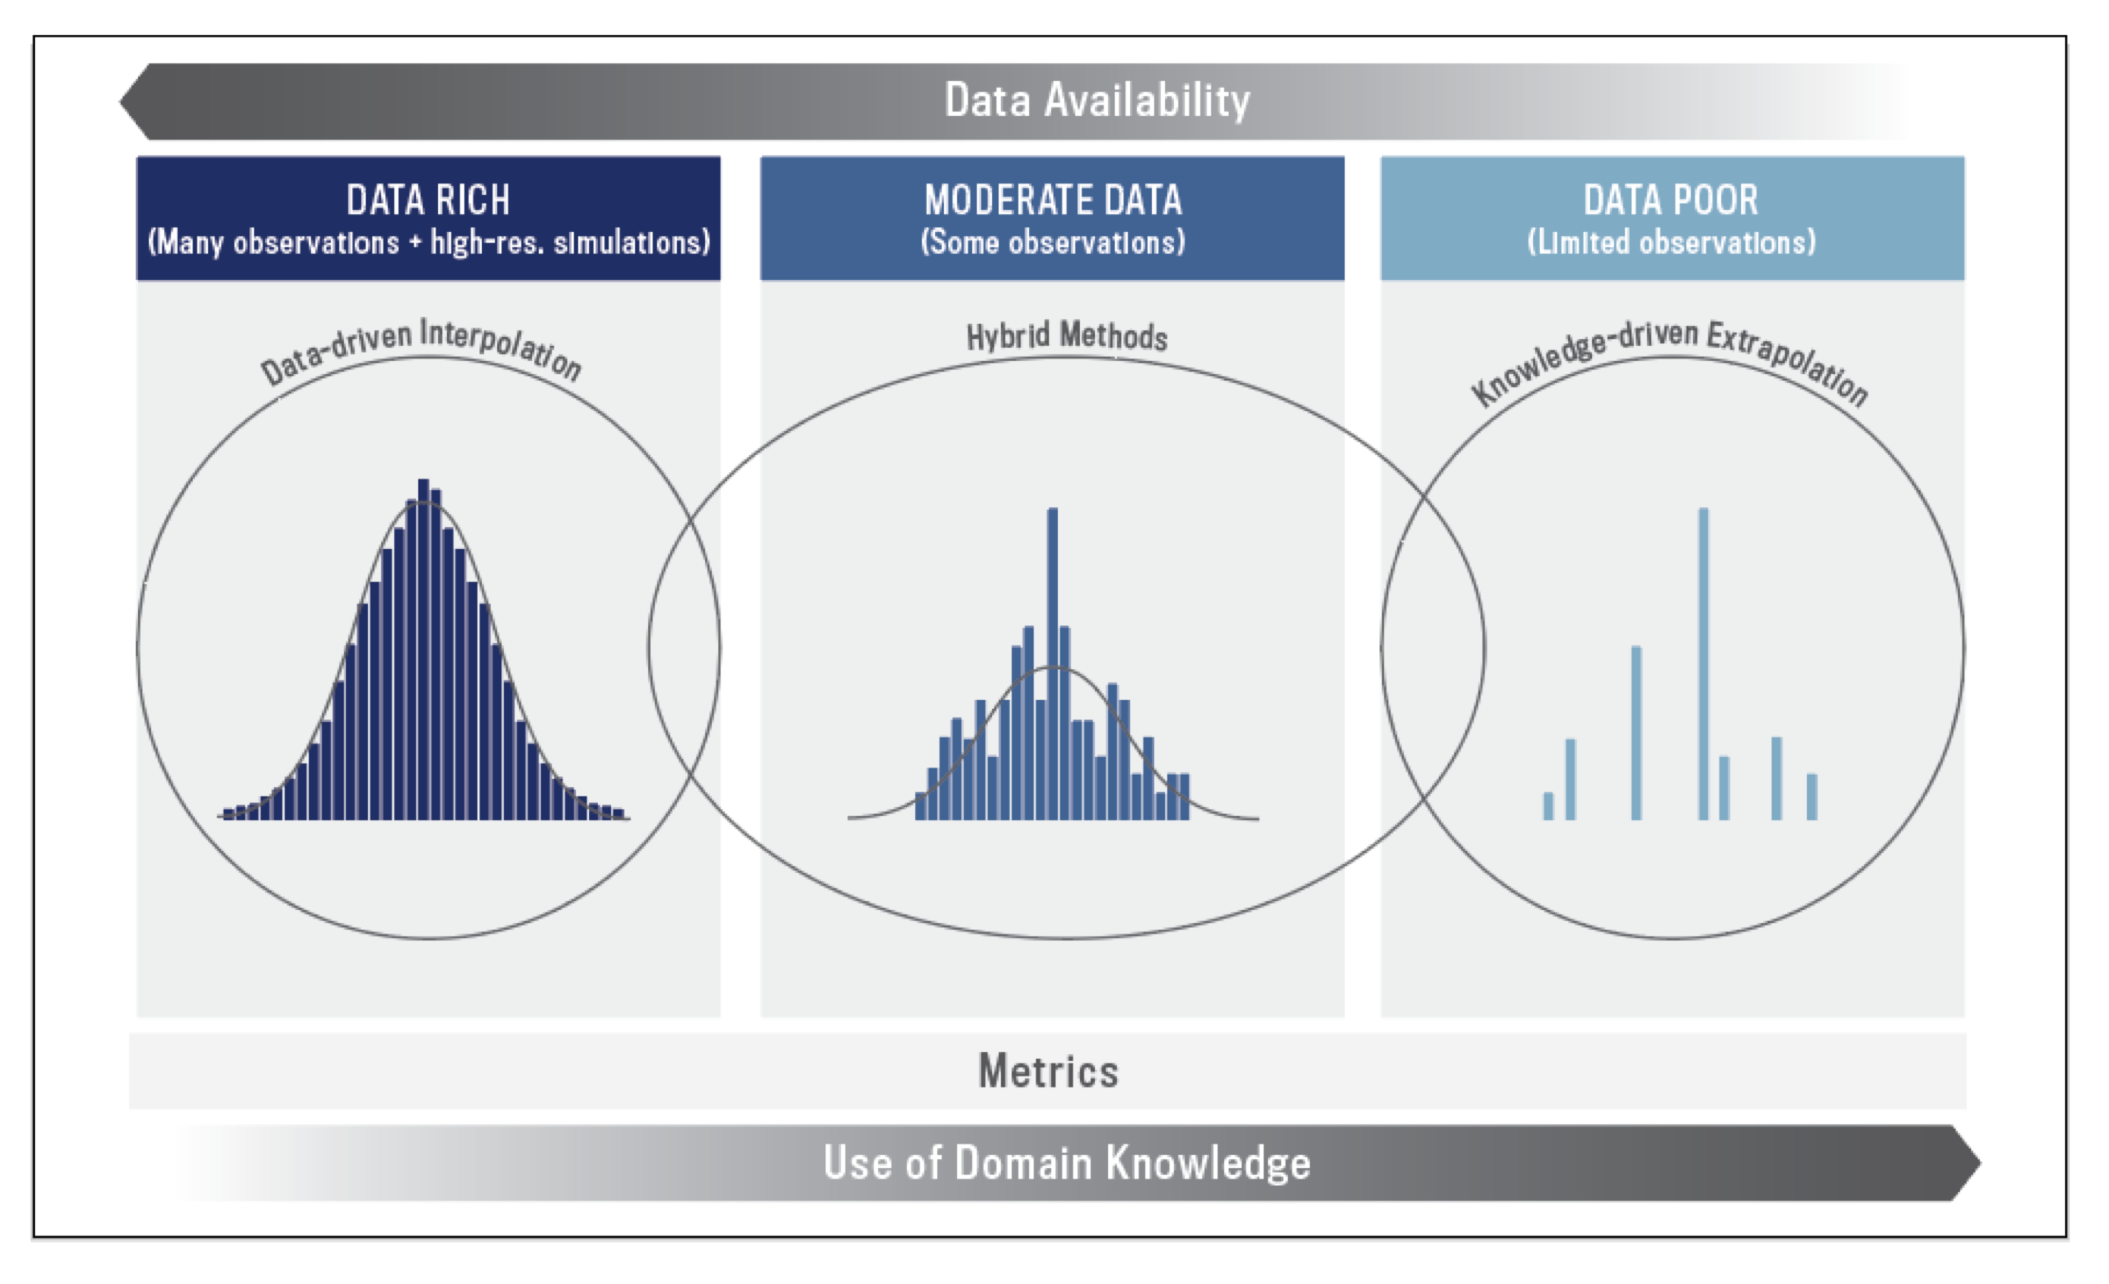
LEAP will discover equations governing the biological pump
Equation for biological pump
Transfer learning

Slide 14
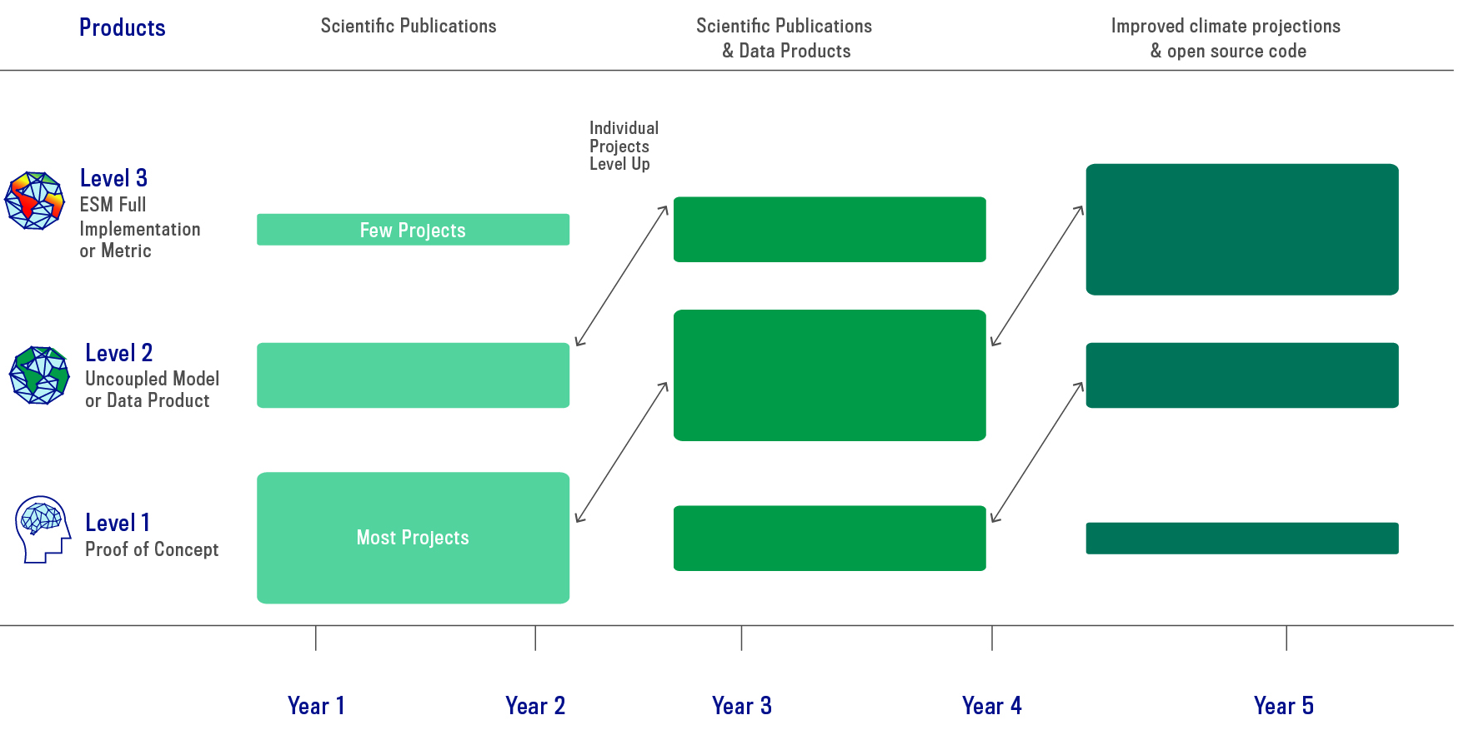
LEAP will advance simultaneously machine learning algorithms, our understanding of Earth system processes & their representation in numerical simulations

Slide 15

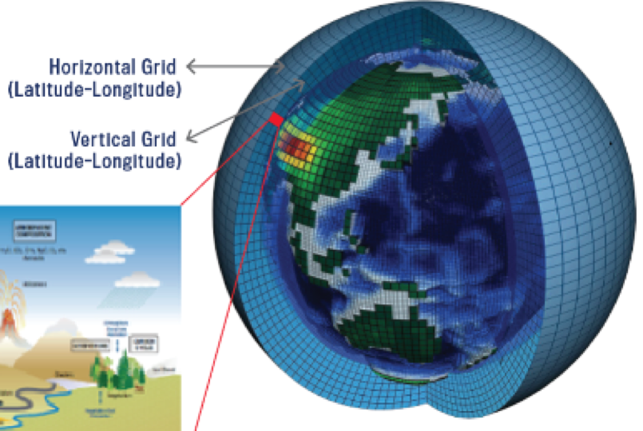
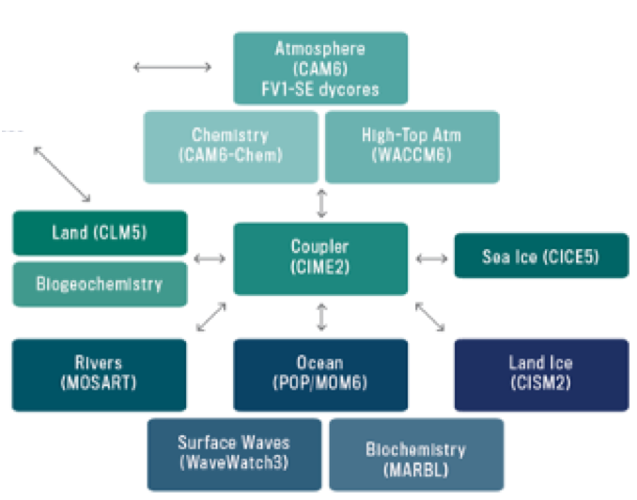
LEAP will advance simultaneously machine learning algorithms, our understanding of Earth system processes & their representation in numerical simulations

Slide 16
Questions?
Dr. Laure Zanna, Professor at NYU
Dr. Carl Vondrick, Asst. Professor at Columbia
Research Co-Directors

